Slide 1

ODataERP
Stefan George, Felix Leupold
Trends and Concepts final presentation

Slide 2
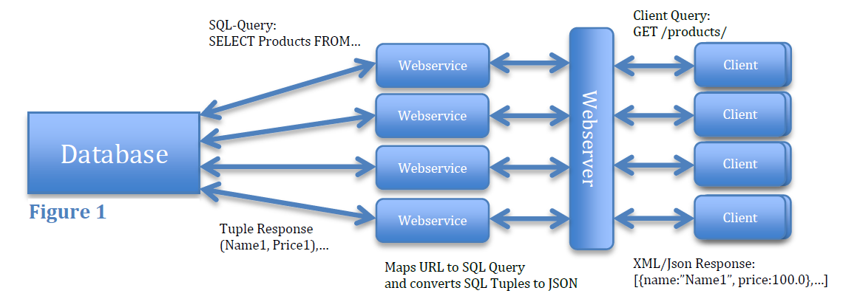
OData (revisited)
Web protocol for querying and updating data
Access database over HTTP
Returns query results as JSON

Slide 3
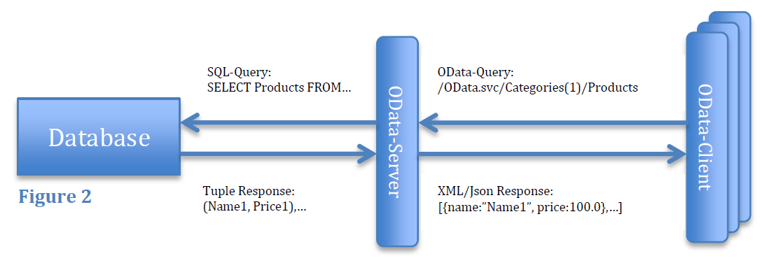
OData (revisited)
Web protocol for querying and updating data
Access database over HTTP
Returns query results as JSON

Slide 4
OData Business Context
ODataERP Stack
Data Overhead/Performance
Application state
Security/Encryption
OData for HPAs
Ideas for improvement

Slide 5
ODataERP Stack
1100 LOC
Serves static files
Handles Communication
Client
Server
jQuery.js
app.js
ASP.NET
OData.svc
jQueryUI.js
datajs.js
MSSQL Server
Stored procedures
DataTables.js

Slide 6
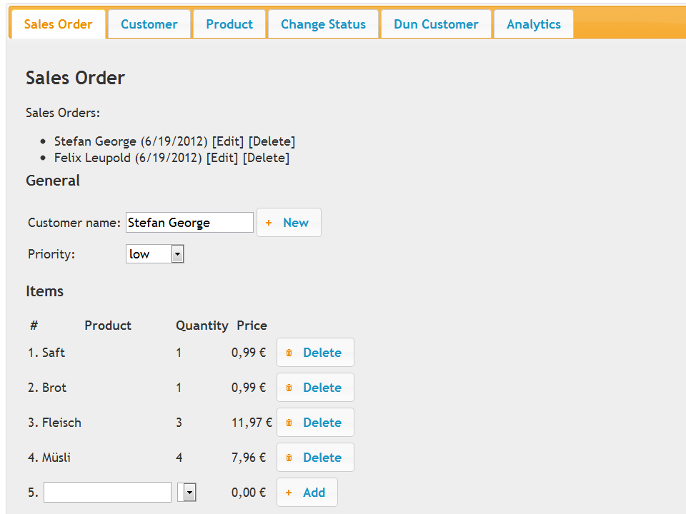
App Screenshot

Slide 7
Data Overhead/Performance
JSON better than Atom
JSON format
URL for foreign keys
Property names for each entry
Notes:
Odata Consortium fragt sich: Wie kann man das verbessern
1 mal Metainformation: danach nur noch die values. Immernoch json

Slide 8
Application state
Complete asynchronous communication
Only one URL
Client
Transaction State
Form State
Authentication State
Server
Session ID
Notes:
Rich Client Anwendung
Authentication auf beiden
Keine Transaktionssicherheit
Internetconnection Lost -> halbe Salesorder
Wegen Async REST -> kein Aufschluss über URL (1 Seite)

Slide 9
Security/Encryption
DOS Attacken
ODataERP.svc/Customer?$top=100000000$expand=Orders
Limit range of possible selections
Limit execution time on data base layer
No encryption in OData:
Use HTTPS
Authorization on entity level:
config.SetEntitySetAccessRule("*", EntitySetRights.All);
No authentication in OData
Authentication on a different layer (e.g. using OAuth)
Notes:
Alle customer mit allen orders -> verlangsamt das system
Keine Hilfe von Microsoft -> Range limit, limit execution time
Wenn solche anfragen kommen immer angriff
Keine Authorization auf Attributebene -> Views
Authentication mit Oauth (kompliziert)

Slide 10
HPAs
OData in context of High Performance Applications
Modern HTML5 web applications
Most of the code is JavaScript (90%)
Using OData for communication
HANA OData Server available
Great for read access
Bad for writing access
Notes:
HPA in Banken um Cacheflow zu analysieren
Odata bereits angewendet
geschwätzig

Slide 11
Ideas
360/1100 = 32% LOC OData Service Functions
Idea: OData ORM for JavaScript
Shorter syntax
Easier to express object creation
Explore Service automatically
Auto completion
Easier to read

Slide 12
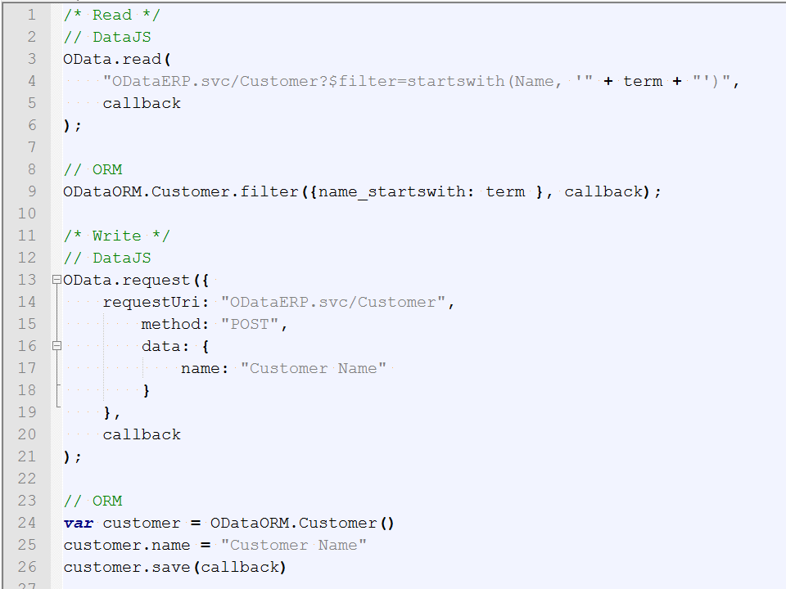

Slide 13
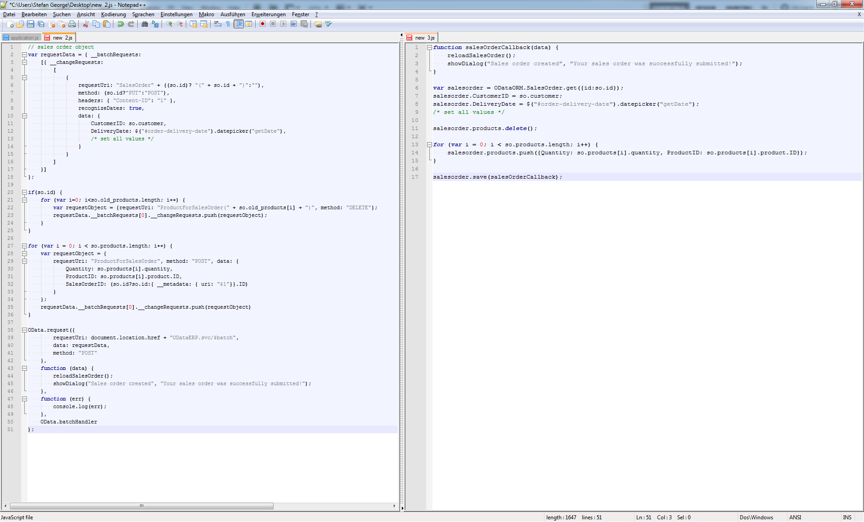
77%

Slide 14
Conclusion
OData is great for exposing data for reading access
Expressive filter syntax
OData is great for smaller analytics/publishing apps
Application server can be crated automatically
Logic lies in Database and JavaScript
One layer of complexity removed
Some security & application state issues in business context
DOS
Transaction State
Notes:
Next Steps
Wie weit ist der Prozess implementiert

